Slide 1


Online Cycle Elimination for Context-Free Language Reachability
CA1
Pei Xu, University of Technology Sydney
Supervised By Prof. Yulei
Notes:
Hi, everyone,
I am Pei. I am honoured to present my first-year candidate assessment on the topic of reducing transitive redundancy in Context-Free Language Reachability, under the supervision of Prof. Yulei.

Slide 2
Overview
Literature Review
Our Work: Online Cycle Elimination (submitted to OOPSLA 2023)
Future Work
Notes:
In this presentation, I will cover three main sections.
First, we will delve into the literature review, which will include an overview of CFLR, its potential applications, and the performance issues associated with existing solutions.
In the second section, I will present our proposed method: online cycle elimination.
Lastly, I will discuss future potential work in this area.

Slide 3
Literature Review
What is CFL-reachability?
Performance limitation of CFL-reachability
Existing Works
Notes:
Let's delve into the literature review, where we will explore three key aspects of CFL-reachability.
Firstly, we will examine the concept of CFL-reachability and understand the standard solving method.
Secondly, we will talk about the performance limitations and challenges associated with CFLR.
Lastly, we will review the existing solutions proposed in the literature to address the performance issues in CFLR.

Slide 4
Literature Review
What is CFL-reachability?
Context-free language reachability (i.e., CFL-reachability) is a fundamental framework for program analysis:
Shape analysis
Data flow analysis
Typestate analysis
Pointer analysis
Notes:
Firstly, let’s have a look what is Context-Free Language.
Originally introduced by Yanakakis in 1990, CFL-Reachability has become a fundamental framework for program analysis. It is used by a range of clients, including points-to analysis, dataflow analysis, typestate analysis, pointer analysis

Slide 5
Literature Review
What is CFL-reachability?
A CFL-reachability problem is to determine whether specific source-sink pairs in a given edge-labeled directed graph are connected by a reachable path.
Reachable path: a path whose edge labels form a string accepted by the given CFL.
Notes:
A CFL-reachability problem is to determine whether specific source-sink pairs in a given edge labeled directed graph are connected by a reachable path.
A reachable path is a path whose edge labels form a string that is accepted by the given CFL

Slide 6
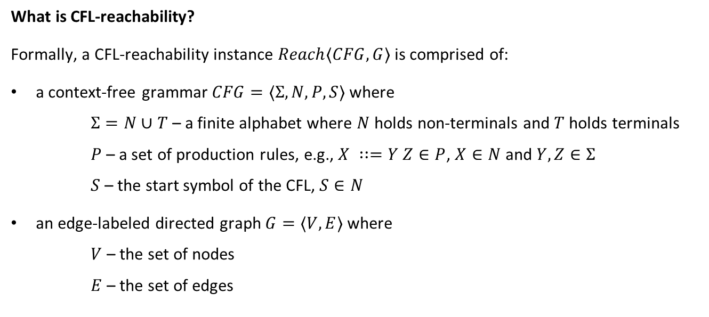
Literature Review
What is CFL-reachability?
Formally, a CFL-reachability instance $Reach⟨CFG, G⟩$ is comprised of:
a context-free grammar $CFG=⟨Σ, N,P,S⟩$ where
$Σ=N∪T$ – a finite alphabet where $N$ holds non-terminals and $T$ holds terminals
$P$ – a set of production rules, e.g., $X ∷=Y Z∈P$, $X∈N$ and $Y,Z∈Σ$
$S$ – the start symbol of the CFL, $S∈N$
an edge-labeled directed graph $G=⟨V,E⟩$ where
$V$ – the set of nodes
$E$ – the set of edges
Notes:
Formally, a CFL-reachability instance Reach CF$G$ and G is comprised of
A context-free grammar CFG sigma, N, P, S where
Where Sigma = N union T which means sigma is a finite alphabet holds of non-terminals N and terminals T.
And P is a set of production rules, for example., X equals to Y Z , where the lefthand side X is a nonterminal, right hand side Y, Z are elements of the alphabet.
Also The start symbol is marked with a capital S.
For the edge-labeled directed graph G, V is the set of nodes and E is the set of edges.

Slide 7
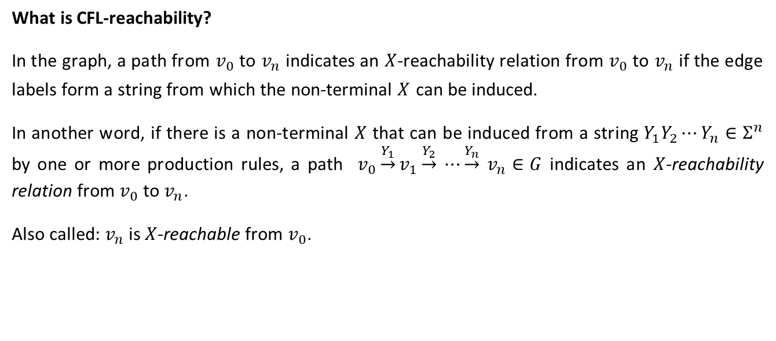
Literature Review
What is CFL-reachability?
In the graph, a path from $v_{0}$ to $v_{n}$ indicates an $X$-reachability relation from $v_{0}$ to $v_{n}$ if the edge labels form a string from which the non-terminal $X$ can be induced.
In another word, if there is a non-terminal $X$ that can be induced from a string $Y_{1}Y_{2}⋯Y_{n}∈Σ^{n}$ by one or more production rules, a path $v_{0}\underset{→}{Y_{1}}v_{1}\underset{→}{Y_{2}}$ $⋯\underset{→}{Y_{n}}$ $v_{n}∈G$ indicates an $X$-reachability relation from $v_{0}$ to $v_{n}$.
Also called: $v_{n}$ is $X$-reachable from $v_{0}$.
Notes:
In the graph, a path from $v_{0}$ to $v_{n}$ indicates an $X$-reachability relation from $v_{0}$ to $v_{n}$ if the edge labels form a string from which the non-terminal $X$ can be induced.
In another word, if there is a non-terminal $X$ that can be induced from a string $Y_{1}Y_{2} to Y_{n}$by one or more production rules, a path $v_{0}\underset{→}{Y_{1}}v_{1}\underset{→}{Y_{2}}$ $to \underset{→}{Y_{n}}$ $v_{n}$ indicates an $X$-reachability relation from $v_{0}$ to $v_{n}$.
Also called: $v_{n}$ is $X$-reachable from $v_{0}$.

Slide 8
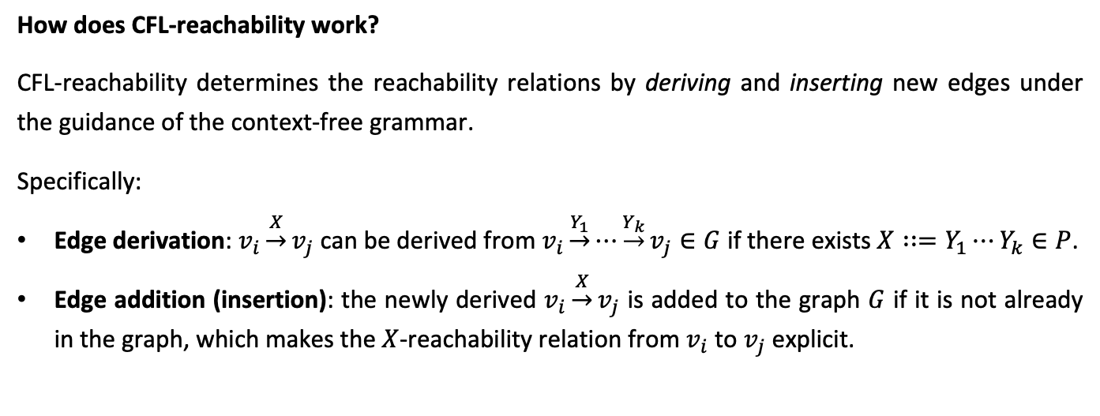
Literature Review
How does CFL-reachability work?
CFL-reachability determines the reachability relations by deriving and inserting new edges under the guidance of the context-free grammar.
Specifically:
Edge derivation: $v_{i}\underset{→}{X}v_{j}$ can be derived from $v_{i}\underset{→}{Y_{1}}⋯\underset{→}{Y_{k}}v_{j}∈G$ if there exists $X∷=Y_{1}⋯Y_{k}∈P$.
Edge addition (insertion): the newly derived $v_{i}\underset{→}{X}v_{j}$ is added to the graph $G$ if it is not already in the graph, which makes the $X$-reachability relation from $v_{i}$ to $v_{j}$ explicit.
Notes:
How does CFL-reachability work?
CFL-reachability determines the reachability relations by deriving and inserting new edges under the guidance of the context-free grammar.
Specifically:
Edge derivation: $v_{i}\underset{→}{X}v_{j}$ can be derived from $v_{i}\underset{→}{Y_{1}}to \underset{→}{Y_{k}}v_{j}$f there exists $X∷=Y_{1} to Y_{k}$.
Edge addition (insertion): the newly derived $v_{i}\underset{→}{X}v_{j}$ is added to the graph $G$ if it is not already in the graph, which makes the $X$-reachability relation from $v_{i}$ to $v_{j}$ explicit.

Slide 9


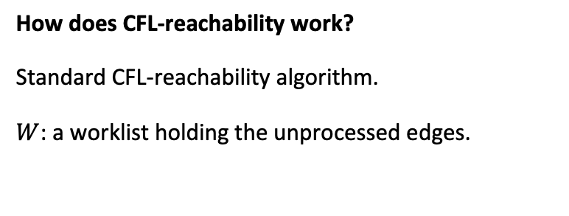
Literature Review
How does CFL-reachability work?
Standard CFL-reachability algorithm.
$W$: a worklist holding the unprocessed edges.
Initialization
$$E$$
$$W$$
worklist
Notes:
Let’s firstly talk about the Standard CFL-reachability algorithm.
The first step is initialization, it define the W to hold the unprocessed edges.

Slide 10
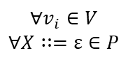
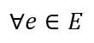
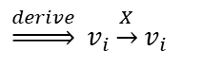
Literature Review
Initialization
How does CFL-reachability work?
Standard CFL-reachability algorithm.
$$E$$
$$∀e∈E$$
$$∀v_{i}∈V$$
$$∀X∷=ε∈P$$
$$\underset{⇒}{derive} v_{i}\underset{→}{X}v_{i}$$
$$W$$
Notes:
Then for all the vertex, if there are any epsilon rules X ::= epsilon. It derives vi X vi
And added to the Edge set and all the edge in the Edge set will be also added to Worklist.

Slide 11
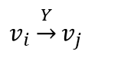
Literature Review
Solving
How does CFL-reachability work?
Standard CFL-reachability algorithm.
$$E$$
$$W$$
$$v_{i}\underset{→}{Y}v_{j}$$
Notes:
After finished the initialization, we start to solve the edge in worklist one by one.
Firstly, we pop up $v_{i}\underset{→}{Y}v_{j}$ as the solving edge.

Slide 12
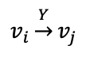

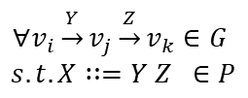
Literature Review
Solving
How does CFL-reachability work?
Standard CFL-reachability algorithm.
$$E$$
$$v_{i}\underset{→}{Y}v_{j}$$
$$∀v_{i}\underset{→}{Y}v_{j}\underset{→}{Z}v_{k}∈G$$
$$s.t. X∷=Y Z ∈P$$
Check successors:
$$W$$
derive
$$v_{i }\underset{→}{X}v_{k}$$
Notes:
To solving the edge $v_{i}\underset{→}{Y}v_{j}$, we firstly do the check successor.
In check successor step: if there is any X equals to Y and Z, and Y edge has Z successor edge, then we could derive the edge $v_{i }\underset{→}{X}v_{k}$.

Slide 13
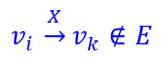
Literature Review
Solving
How does CFL-reachability work?
Standard CFL-reachability algorithm.
$$E$$
$$v_{i }\underset{→}{X}v_{k}∉E$$
Check successors:
$$W$$
Notes:
If the edge is currently not in Graph, then it will be add to graph to make explicity, and added to worklist for the later solving.

Slide 14
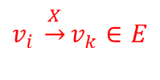
Literature Review
Solving
How does CFL-reachability work?
Standard CFL-reachability algorithm.
$$E$$
$$v_{i }\underset{→}{X}v_{k}∈E$$
Check successors:
Discard
$$W$$
Notes:
On the other hand, if the edge is already in the graph, then this edge will be discarded.

Slide 15
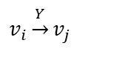
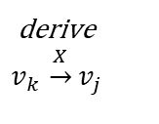
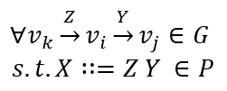
Literature Review
Solving
How does CFL-reachability work?
Standard CFL-reachability algorithm.
$$E$$
$$v_{i}\underset{→}{Y}v_{j}$$
$$∀v_{k}\underset{→}{Z}v_{i}\underset{→}{Y}v_{j}∈G$$
$$s.t. X∷=Z Y ∈P$$
Check predecessors:
derive
$$v_{k }\underset{→}{X}v_{j}$$
$$W$$
Notes:
Similar to check successor edge.
If edge vi Y vj, has production rules X equals to Z and Y, and Y edges has the Z edges as the predecessors such that
X equals to Z and Y.
Then we could generate the new edges by connect the source of predecessors and destination of the Y edges
And derive vk X vj.

Slide 16
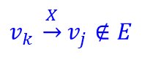
Literature Review
Solving
How does CFL-reachability work?
Standard CFL-reachability algorithm.
$$E$$
$$v_{k }\underset{→}{X}v_{j}∉E$$
Check predecessors:
$$W$$
Notes:
Also if the new generated edge is not the graph, it will be added to the edge set E and worklist W.

Slide 17
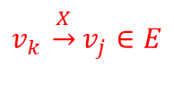
Literature Review
Solving
How does CFL-reachability work?
Standard CFL-reachability algorithm.
$$E$$
$$v_{k }\underset{→}{X}v_{j}∈E$$
Check predecessors:
Discard
$$W$$
Notes:
If it is already in the graph that edges will be discarded.

Slide 18
Literature Review
Limitation
The complexity of Standard Algorithm of CFL-reachability is cubic in respect of graph size, .
This makes the CFL-reachability solving inefficient in large size of input..
Notes:
By looking through the standard solving process we can find that, the solving process is cubic in respect of graph size,
This makes the CFL-reachability solving is inefficient in large size of input, and also make CFLReachability hard to scale to real world size program.

Slide 19
Literature Review
Existing Works
Incremental Analysis
Parallelism Analysis
Graph Simplification
Improved CFL-reachability Algorithm
Notes:
The existing works to solve this issue are from different angle.
Which includes incremental analysis, parallelism analysis, offline graph simplification, improved CFL-Reachability.

Slide 20
Literature Review
Existing Works
Graph Simplification
Reduce the size of graph and maintain same CFL-Reachability result.
Cycle Elimination
Collapse the same elements in cycles and maintain same CFL-Reachability Result, but only limited to the stage before solving (offline)
Notes:
The existing works to solve this issue are from different angle.
Which includes incremental analysis, parallelism analysis, offline graph simplification, improved CFL-Reachability.
Since the solving is a cubic complexity, graph simplification can reduce the size of the graph while maintain same CFLReachability result which make graph simplification desirable.
Among various graph simplification techniques, the cycle elimination is most well used one, which collapse the same element in the cycle and reduce the size of both nodes and edges.
However the cycle elimination in CFL-Reachability current work is limited to the stage before solving, offline only.

Slide 21
Literature Review
Existing Works
Equivalence relations could facilitate the merging of nodes/edges in a graph may not be apparent until dynamic CFL-Reachability is performed.
There is a need for online graph simplification techniques for CFL-reachability
Notes:
Our study has shown that many equivalence relations that could facilitate the merging of nodes/edges in a graph may not be apparent until dynamic CFL-reachability solving is performed. As a result, there is a need for online graph simplification techniques for CFL-reachability, which has not been thoroughly investigated to date.

Slide 22
Our Work: Online Cycle Elimination
Motivating Example
Approach
Evaluation
Notes:
Now we will introduce the our work: online cycle elimination.
It will include the Motivating example, approach and evaluation.

Slide 23
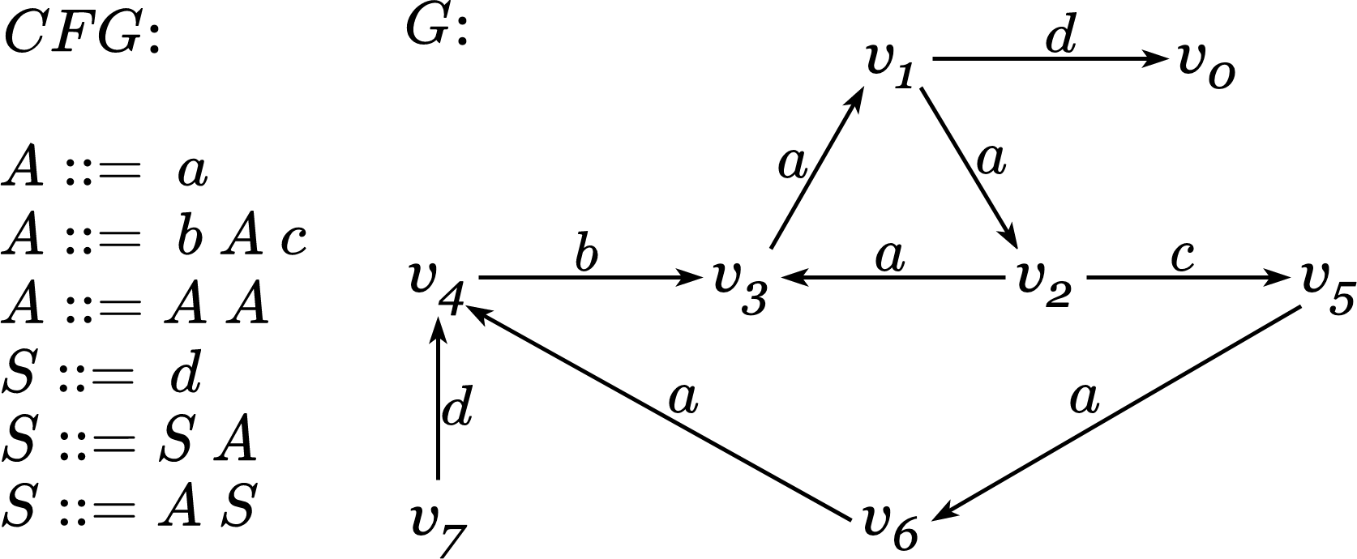
Our Work: Online Cycle Elimination
Motivating Example.
Standard solving:
Notes:
Here gives a context free grammar in the left side and a edge labelled directed graph in the middle.
In graph G, we could find that v1 v2 v3 is formed a “a” labelled cycle.

Slide 24
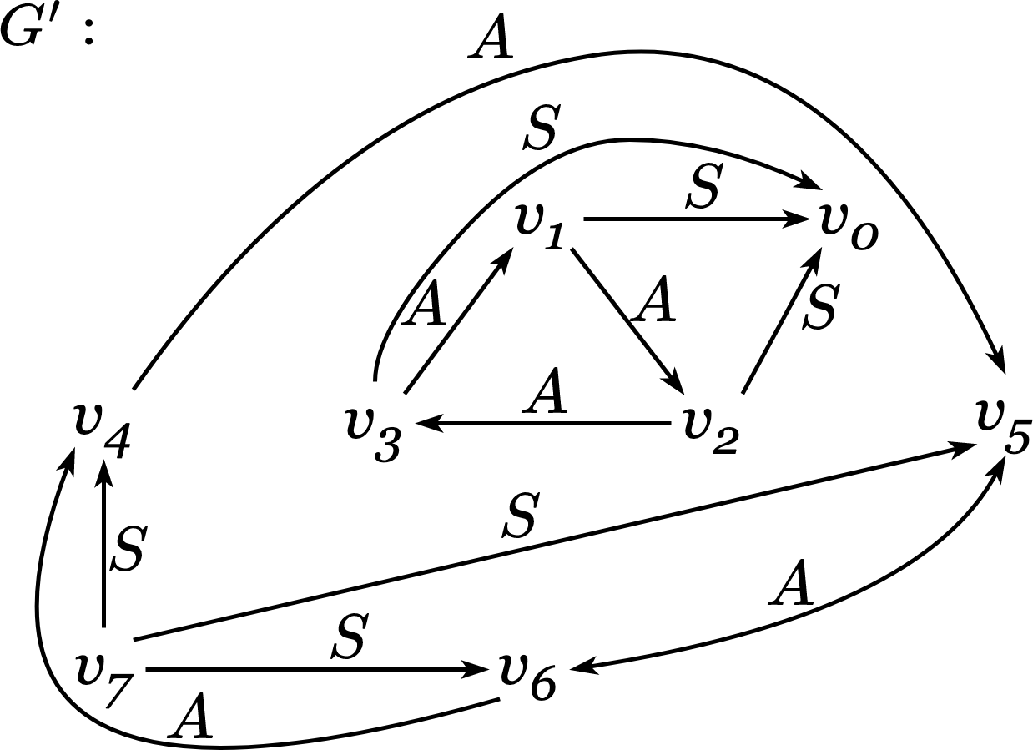
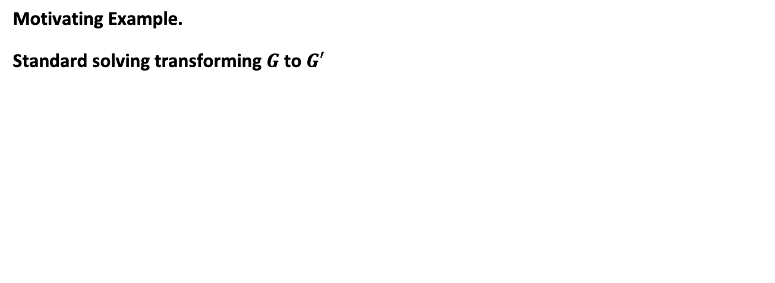
Our Work: Online Cycle Elimination
Motivating Example.
Standard solving transforming $G$ to $G′$
Notes:
After the standard solving, graph G is transformed to graph G’.
Since Nonterminal A equals to terminal a, in G’ v1, v2, v3 is transformed to nonterminal A cycle.
What’s more, v4, v5, v6 is transformed to another A cycle which is not shown in G.

Slide 25
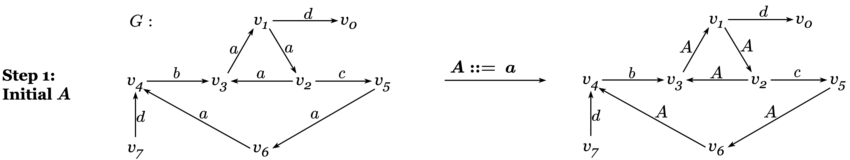
Our Work: Online Cycle Elimination
Motivating Example.
Three-step online cycle elimination solving:
Notes:
Now we looking at the online cycle elimination way to solved this graph.
In the step 1, the we find the transitive element nonterminal A is equals to terminal a.
And transformed all the terminal a to nonterminal A.

Slide 26
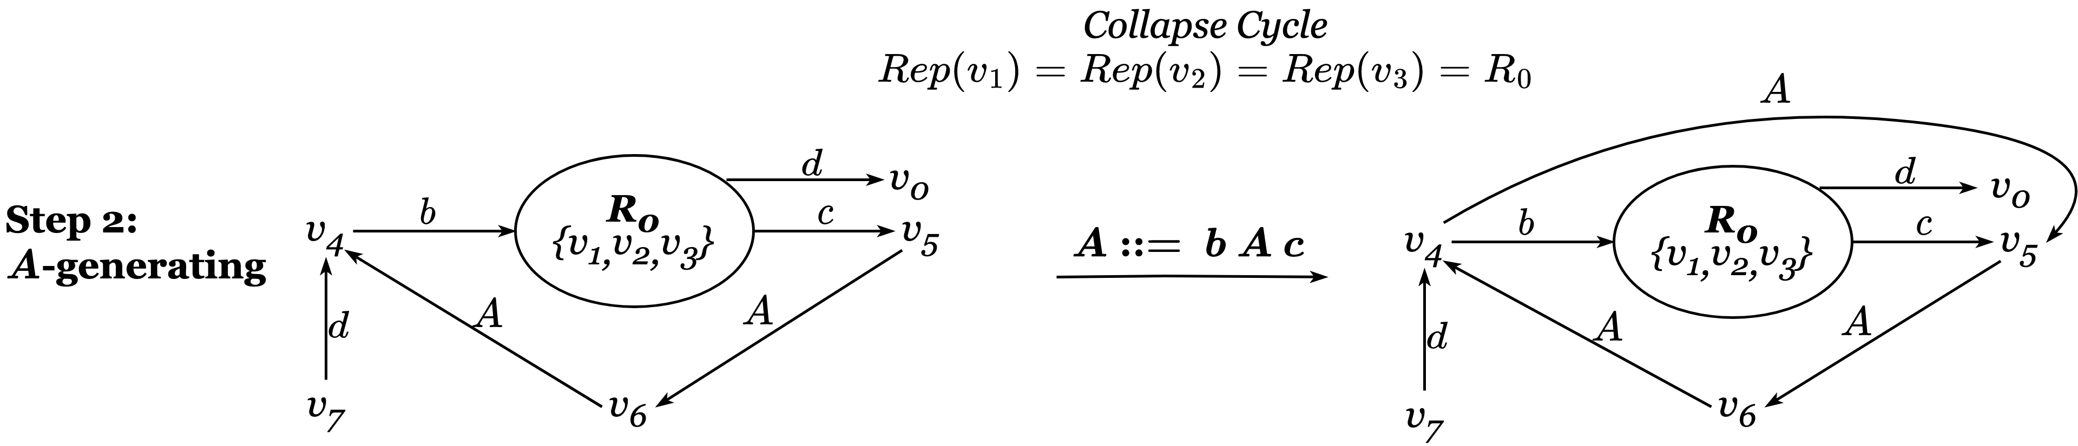
Our Work: Online Cycle Elimination
Motivating Example.
Three-step online cycle elimination solving:
Notes:
Before Step 2, we collapse cycle the cycle v1,v2,v3 to representation node R0
And apply other possible A generating rules like A is equals to terminal b A and terminal c.
After this graph formed another cycle v4, v5, v6.

Slide 27
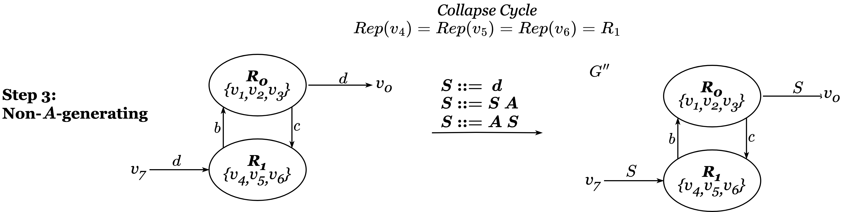
Our Work: Online Cycle Elimination
Motivating Example.
Three-step online cycle elimination solving:
Notes:
Similarly, before the Step 3 non-A-generating step, we collapse cycle v4, v5, v6 to Representation node R1.
Then in step 3, we apply the rest of rules to finished solving.

Slide 28
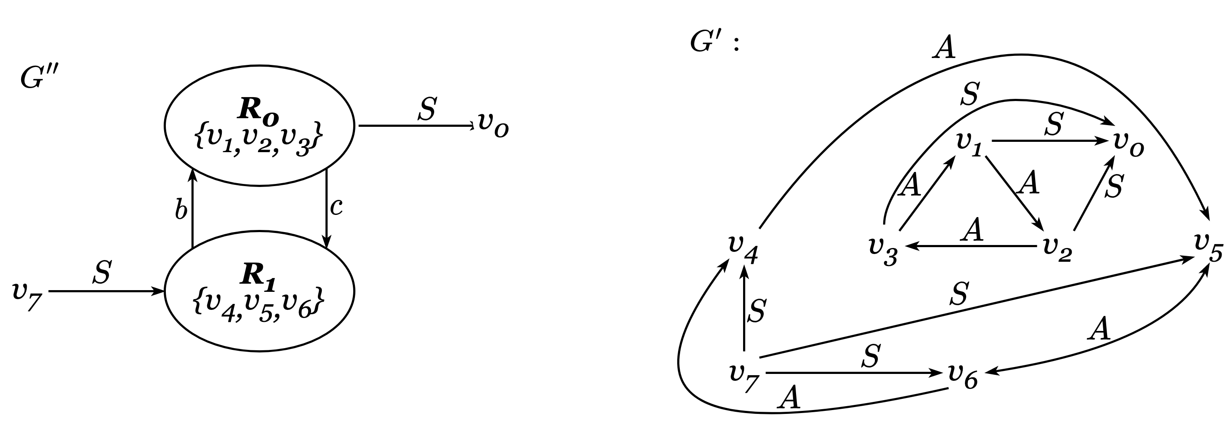
Our Work: Online Cycle Elimination
Motivating Example.
Comparison with standard solving:
Notes:
As shown in the comparison, G’’ and G’ is share the same CFL-Reachability Solution.
V7 is S reachable to v4, v5, v6, and v1, v2, v3 is S reachable to v0.
However, G’’ used online cycle elimination significant reduced the size the graph.

Slide 29



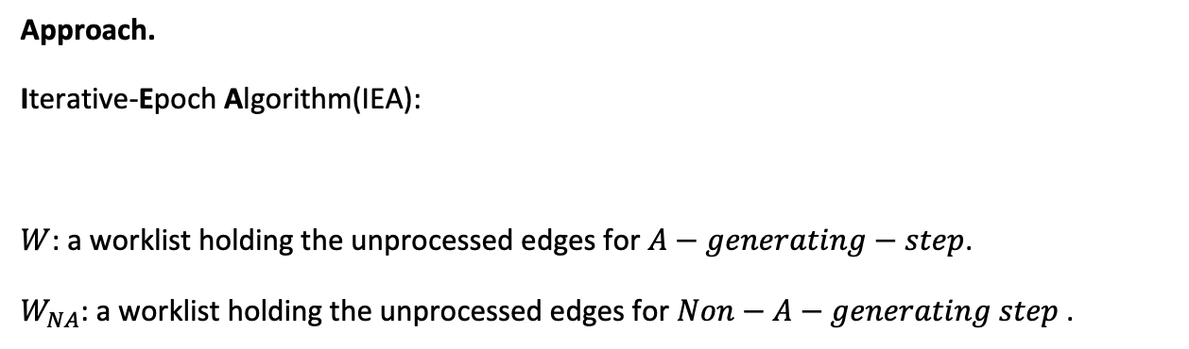
Our Work: Online Cycle Elimination
Initialization
Approach.
Iterative-Epoch Algorithm(IEA):
$W$: a worklist holding the unprocessed edges for $A−generating−step$.
$W_{NA}$: a worklist holding the unprocessed edges for $Non−A−generating step$.
$$E$$
$$W$$
$$W_{NA}$$
Notes:
Here we give the detailed iterative-epoch algorithm solution of online cycle elimination.
Similar to standard solving the we firstly initialize the E set and Worklist W. But we also need an additional a worklist Wna is hold the unprocessed edges for Non-A-generating step, and original worklist W is used to hold the unprocessed edges for A-generating step.

Slide 30
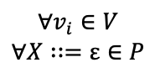


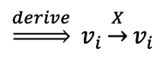
Our Work: Online Cycle Elimination
Approach.
Iterative-Epoch Algorithm(IEA):
Initialization
$$E$$
$$∀e∈E$$
$$∀v_{i}∈V$$
$$∀X∷=ε∈P$$
$$\underset{⇒}{derive} v_{i}\underset{→}{X}v_{i}$$
$$W$$
worklist
Notes:
Same with Standard solving, then we will check all the node in Vertex and it there is any epsilon rules it will derived edges vi X vi to worklist W and copy all the edges in edge set to worklist.

Slide 31
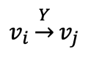

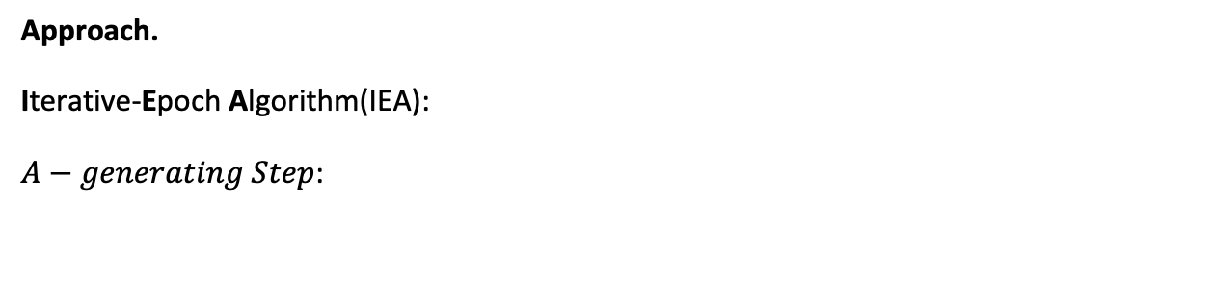
Our Work: Online Cycle Elimination
Approach.
Iterative-Epoch Algorithm(IEA):
$A−generating Step$:
Solving
$$E$$
$$W$$
$$v_{i}\underset{→}{Y}v_{j}$$
Notes:
Then we start solving, in the A-generating Step, we used worklist W to popped the edge vi Y vj.

Slide 32



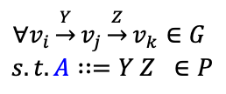
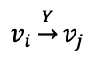
Our Work: Online Cycle Elimination
Approach.
Iterative-Epoch Algorithm(IEA):
$A−generating Step$:
Solving
$$E$$
$$∀v_{i}\underset{→}{Y}v_{j}\underset{→}{Z}v_{k}∈G$$
$$s.t. A∷=Y Z ∈P$$
$$W$$
Check successors:
derive
$$v_{i }\underset{→}{A}v_{k}$$
$$v_{i}\underset{→}{Y}v_{j}$$
$$W_{NA}$$
Notes:
Then same with standard solving, we check the successor of edge vi Y vj, if there are any matched edges with production A equals to Y and Z we derived the transitive A edge.

Slide 33

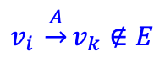
Our Work: Online Cycle Elimination
Approach.
Iterative-Epoch Algorithm(IEA):
$A−generating Step$:
Solving
$$E$$
$$W$$
Check successors:
$$v_{i }\underset{→}{A}v_{k}∉E$$
$$W_{NA}$$
Notes:
And if vi A vk is not in edge set yet, A will be added to E edges set and Worklist Wna instead of W.

Slide 34

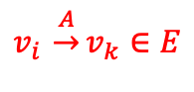
Our Work: Online Cycle Elimination
Approach.
Iterative-Epoch Algorithm(IEA):
$A−generating Step$:
Solving
$$E$$
$$v_{i }\underset{→}{A}v_{k}∈E$$
$$W$$
Check successors:
Discard
$$W_{NA}$$
Check predecessor…
Notes:
And if vi A vk is already in Edge set, then edge will be discarded.

Slide 35


Our Work: Online Cycle Elimination
Approach.
Iterative-Epoch Algorithm(IEA):
$Collapse Cycle Step$
Solving
$$E$$
$$W$$
$$W_{NA}$$
Notes:
Then we will collapse cycle formed by new generated A edge.

Slide 36

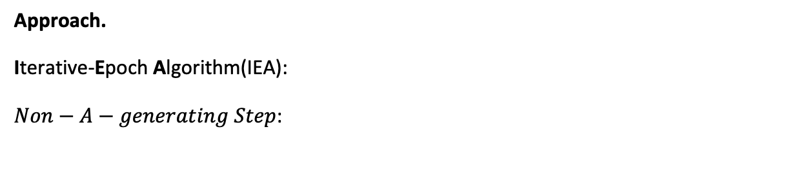
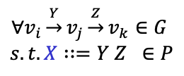
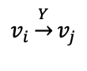

Our Work: Online Cycle Elimination
Approach.
Iterative-Epoch Algorithm(IEA):
$Non−A−generating Step$:
Solving
$$E$$
$$v_{i}\underset{→}{Y}v_{j}$$
$$∀v_{i}\underset{→}{Y}v_{j}\underset{→}{Z}v_{k}∈G$$
$$s.t. X∷=Y Z ∈P$$
$$W$$
Check successors:
derive
$$v_{i }\underset{→}{X}v_{k}$$
$$W_{NA}$$
Notes:
Then goes to Non-A-generating Step, for edge vi Y vj poped up from Worklist Wna, then we check the successors of Y, if there are Z edges match with rules X equals to Y and Z, then derived edge vi X vk.

Slide 37
Our Work: Online Cycle Elimination
Approach.
Iterative-Epoch Algorithm(IEA):
$Non−A−generating Step$:
Solving
$$E$$
$$W$$
$$v_{i }\underset{→}{A}v_{k}∉E$$
Check successor:
$$W_{NA}$$
Notes:
Reversely, if the edge is new edge, edge will be added to worklist W.

Slide 38
Our Work: Online Cycle Elimination
Approach.
Iterative-Epoch Algorithm(IEA):
$Non−A−generating Step$:
Solving
$$E$$
$$W$$
Check predecessor …
$$W_{NA}$$
Notes:
Check predecessor is similar.

Slide 39
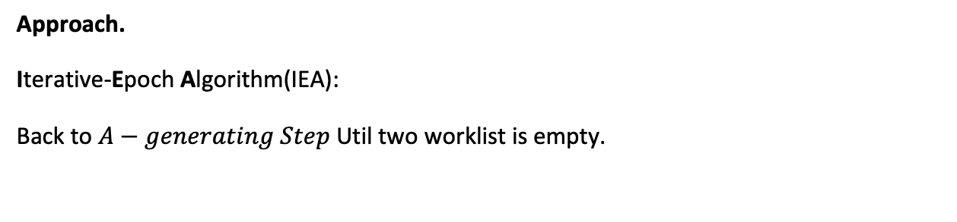
Our Work: Online Cycle Elimination
Approach.
Iterative-Epoch Algorithm(IEA):
Back to $A−generating Step$ Util two worklist is empty.
Solving
$$E$$
$$W$$
$$W_{NA}$$

Slide 40
Our Work: Online Cycle Elimination
Approach.
Iterative-Epoch Algorithm(IEA) is not limited to the standard solving and also same strategy can be implemented on other improved algorithm.
Iterative-Epoch Partial Order CFL-Reachability Algorithms (IEPOCR):
Edge derivations can benefit from both cycle elimination and the spanning-tree-based partially ordered derivation
Notes:
Iterative-Epoch Algorithm is not limited to the standard solving and also same strategy can be implemented on other improved algorithm.
For Iterative-Epoch Partial Order CFL-Reachability Algorithms , edge derivations can benefit from both cycle elimination and the spanning-tree-based partially ordered derivation.

Slide 41
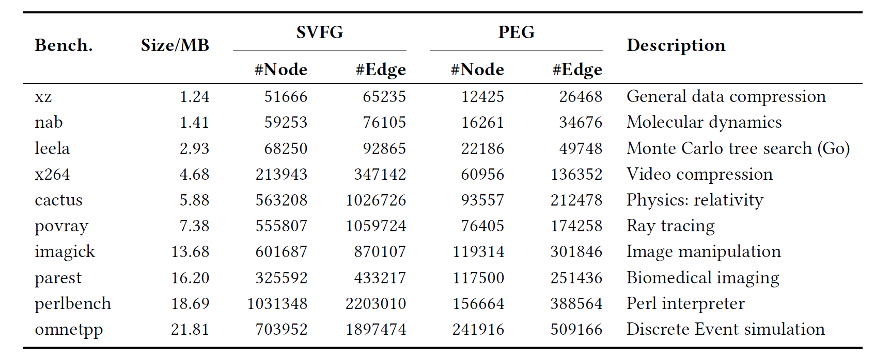
Our Work: Online Cycle Elimination
Evaluation
Context-sensitive value-flow analysis.
Benchmarks
Notes:
Setup and Benchmarks. The SVFG of each program was generated by first compiling their corresponding bitcode files with Clang-14.0.0 and linking them using wllvm2 for whole-program all-pairs CFL-reachability analysis. The evaluation in our study used 10 programs written in C/C++ from the SPEC 2017 benchmark suite. To ensure a fair evaluation, we excluded three small programs (lbm, mcf and deepsjeng) that were less than 1 MB in size.

Slide 42
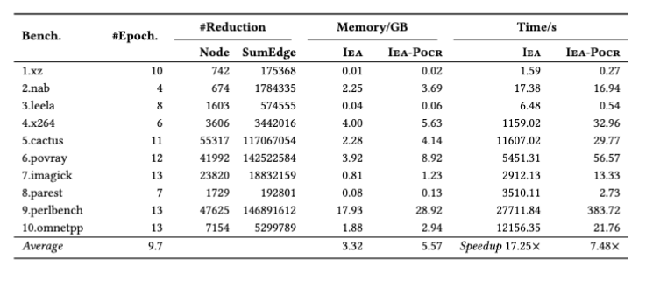
Evaluation
Reduction of redundancy, memory and speedup
Context-sensitive value-flow analysis.
Notes:
we evaluate the performance of CFL-reachability with online cycle elimination by conducting two separate sets of experiments implemented on the same client. The first set of experiments compares the standard algorithm [Melski and Reps 2000] with Iea ( Algorithm 2). The second set of experiments compares Pocr [Lei et al . 2022] with Iea-Pocr,
Our experiments shows that IEA and IEA-POCR achieved 17.25 times and 7.48 times speedup over its baseline respectively.

Slide 43
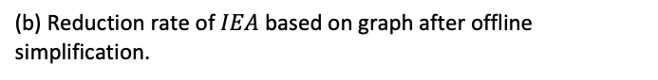
Evaluation
Reduction of redundancy and speedup
Statistics of computational redundancy.
(a) Reduction rate of offline simplification (i.e., OSCC + OVS) based on initial graph.
(b) Reduction rate of $IEA$ based on graph after offline simplification.
Notes:
Figure the reduction rates of offline graph simplification and Iea. A comparison of Figure 9(a) and Figure 9(b) shows that (1) offline methods are effective to reduce a large proportion of nodes (64.67% on average) and edges (49.35% on average) from the initial graph; and (2) even after the offline graph simplification, Iea is still able to further reduce more than 10% of nodes and around 50% of summary edges during the online solving. This underscores the necessity of applying online graph simplification on top of offline graph simplification. It is worth mentioning that, even if OSCC is removed, Iea is able to collapse the nodes in 𝑎-cycles in the first epoch given 𝐴 ::= 𝑎. Therefore, online cycle elimination can be seen as an upgrade over offline cycle elimination, with the ability to collapse both shallow offline cycles and dynamically generated online cycles

Slide 44
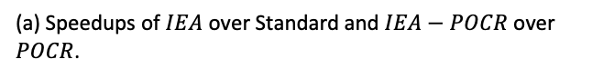
Evaluation
Reduction of redundancy and speedup
Statistics of speedups.
(a) Speedups of $IEA$ over Standard and $IEA−POCR$ over $POCR$.
(a) Reduction rate of offline simplification (i.e., OSCC + OVS) based on initial graph.
Notes:
The speedups of Iea over Std are displayed as the blue bars in Figure 10(a), which is computed using the data in Column 7 of Table 2 and Column 9 of Table 1. The result shows that the utilization of online cycle elimination in Iea leads to a significant average speedup of 17.25× over the standard algorithm. Moreover, Iea successfully completes the analyses for all the 10 benchmarks where Std fails in six of ten. This substantial improvement is achieved by online cycle elimination with only around 10% of total nodes reduced, indicating that a small proportion of nodes in cycles contribute to a significant amount of redundant computation in edge solving, which aligns with the cubic complexity of the standard algorithm.

Slide 45
Evaluation
Reduction of redundancy and speedup
Statistics of memory reduction.
(a) Reduction rates of memory overhead of $IEA$ over Standard and $IEA−POCR$ over $POCR$.
Notes:
Figure 11 displays the reduction rates of memory overhead of Iea over Std and Iea-Pocr over Pocr. On average, Iea effectively reduced 48.81% memory overhead of Std, while Iea-Pocr reduced 53.65% memory overhead of Std, which is even more significant.

Slide 46

Future Works
Smart Contract Analysis with IEA
Parallelism IEA
POCR Memory Improvement
Anderson equivalent CFL-reachability
Automate Grammar Rewriter
Notes:
Future work will includes smart contract analysis with IEA,
Parallelism IEA
POCR memory improvement
Anderson equivalent CFL-reachability
Automate grammar rewriter

Slide 47
Thank you!
Pei Xu
Pei.Xu@student.uts.edu.au
Notes:
Thank you

